Slide 1
Concept learning
Maria Simi, 2011/2012
Machine Learning, Tom Mitchell
Mc Graw-Hill International Editions, 1997
(Cap 1, 2).
Notes:
1

Slide 2
Concept Learning
The problem of inducing general functions from specific training examples is central to learning.
Concept learning: Acquiring the definition of a general category given a sample of positive and negative training examples of the category.
This can be formulated as a problem of searching through a predefined space of potential hypotheses for the hypothesis that best fits the training examples.
This search can be done by general -to-specific ordering of hypotheses.

Slide 3
Concept Learning
Each concept can be thought of as a boolean-valued function defined over this larger set.
Concept learning. Inferring a boolean-valued function from training examples of its input and output.

Slide 4
A CONCEPT LEARNING TASK
Consider the example task of learning the target concept "days on which my friend Aldo enjoys his favorite water sport."
Table 2.1 describes a set of example days, each represented by a set of attributes.
The attribute EnjoySport indicates whether or not Aldo enjoys his favorite water sport on this day.
The task is to learn to predict the value of EnjoySport for an arbitrary day, based on the values of its other attributes.

Slide 5
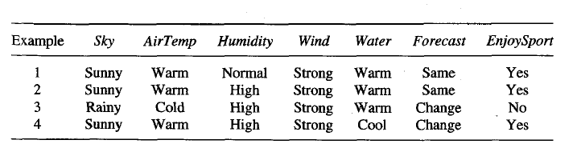

Slide 6
A CONCEPT LEARNING TASK
A simple representation is in which each hypothesis
consists of a conjunction of constraints on the instance attributes.
.For our example hypothesis be a vector of six constraints.
For each attribute, the hypothesis will either
indicate by a "?' that any value is acceptable for this attribute,
specify a single required value (e.g., Warm) for the attribute, or
indicate by a "Ø" that no value is acceptable.

Slide 7
Example hypothesis is Aldo enjoys his favorite sport only on cold days with high humidity (?, Cold, High, ?, ?, ?).
An instance x satisfies an hypothesis h iff all the constraints expressed by h are satisfied by the attribute values in x.
Consider x3 in the example it satisfies the given hypothesis.

Slide 8
Notation
The set of items over which the concept is defined
is called the set of instances, which we denote by X.
In the current example, X is the set of all possible days, each represented by the attributes Sky, AirTemp,Humidity, Wind, Water, and Forecast.
The concept or function to be learned is called the target concept, which we denote by c.
In general, c can be any boolean valued function defined over the instances X; that is,
c : X -> {O, 1).
Ex: c(x) = 1 if EnjoySport = Yes,
and c(x) = 0 if EnjoySport = No

Slide 9
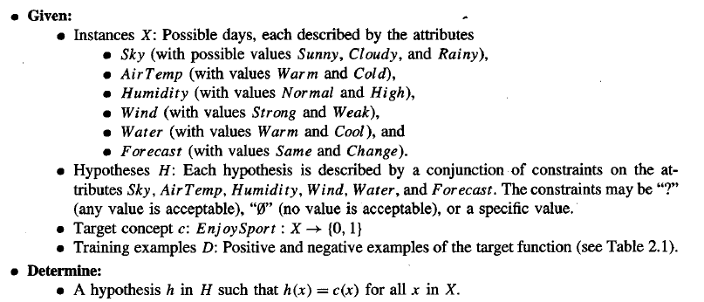

Slide 10
The Inductive Learning Hypothesis
Inductive learning algorithms can at best guarantee that the output hypothesis fits the target concept over the training data.
The inductive learning hypothesis. Any hypothesis found to approximate the target function well over a sufficiently large set of training examples will also approximate the target function well over other unobserved examples
i.e. given a significant training set, the output hypothesis is able to make predictions

Slide 11
Concept learning as search
Concept learning is a task of searching an hypotheses space
The representation chosen for hypotheses determines the search space.
By selecting a hypothesis representation, the designer of the learning algorithm implicitly defines the space of all hypotheses that the program can ever represent and therefore can ever learn
In the enjoysport example we have:
3x2x2x2x2x2 = 96 possible instances (6 attributes)
1 +( 4 x3x3x3x3x3)= 973 possible hypothesis considering that all the hypothesis with some ∅ are semantically equivalent hypotheses, i.e. inconsistent
Structuring the search space may help in searching more efficiently
Most practical learning tasks involve much larger, sometimes
infinite, hypothesis spaces.
Notes:
11
|H| sono tutte le possibile ennuple senza il valore 0 (escludiamo ennuple che non sono mai soddisfatte) più la ennupla con tutti 0

Slide 12
General to specific ordering
Many algorithms for concept learning organize the search through the hypothesis space by relying on a very useful structure that exists for any concept learning problem: a general-to-specific ordering of hypotheses.
By taking this structure we can design learning algorithms that exhaustively search even infinite hypothesis spaces without explicitly enumerating every hypothesis
Consider:
h₁ = 〈Sunny, ?, ?, Strong, ?, ?〉
h₂ = 〈Sunny, ?, ?, ?, ?, ?〉
Now consider the sets of instances that are classified positive by hl and by h2.

Slide 13
General to specific ordering
Any instance classified positive by h₁ will also be classified positive by h₂
h₂ is more general than h₁
Given hypotheses hj and hk, hj is more_general_than_or_
equal_to hk if and only if any instance that satisfies hk also satisfies hi.
Definition: h_{j} ≥_{g} h_{k} iff (∀x ∈ X ) [(h_{k} (x)= 1) → (h_{j} (x)= 1)]
≥_{g} more general or equal; >_{g} strictly more general
Most general hypothesis: 〈?, ?, ?, ?, ?, ?〉
Most specific hypothesis: 〈Ø, Ø, Ø, Ø, Ø, Ø〉
Notes:
13

Slide 14

consider cases where one hypothesis is strictly more
general than the other.
Therefore, we will say that hj is (strictly) more_general_than hk (written hj >g hk) if and only
We will sometimes find the inverse useful and will say that hj is more_specific_than hk when hk is more_general_than hj.
Example:consider the three hypotheses hl, h2, and
h3 from our Enjoysport example
How are these three hypotheses related by the >=g relation

Slide 15
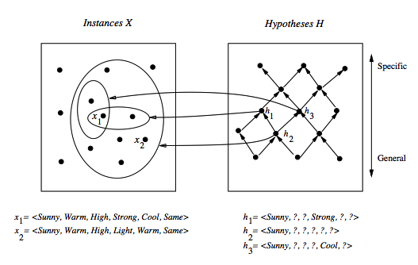
General to specific ordering: induced structure
Notes:
15
Partial order: reflexive, anti--symmetric, transitive.

Slide 16
As noted earlier, hypothesis h2 is more general than hl because every instance that satisfies hl also satisfies h2. Similarly, h2 is more general than h3.
Note that neither hl nor h3 is more general than the other; although the instances satisfied by these two hypotheses intersect.
Formally, the >=g, relation defines a partial order over the hypothesis space H
The >=g relation is important because it provides a useful structure over the hypothesis space H for any concept learning problem

Slide 17
Find-S: finding the maximally specific hypothesis
Exploiting the structure we have alternatives to enumeration …
Initialize h to the most specific hypothesis in H
For each positive training instance:
for each attribute constraint a in h:
If the constraint a is satisfied by x then do nothing
else replace a in h by the next more general constraint
satified by x (move towards a more general hp)
Output hypothesis h
Notes:
17

Slide 18

Begin with the most specific possible hypothesis in H, then generalize this hypothesis each time it fails to cover an observed positive training example.
The learner is given the sequence of training examples from Table 2.1 for the EnjoySport task
The first step of FINDS is to initialize h to the most specific hypothesis in H
Upon observing the first training examplewhich happens to be a positive example, it becomes clear that our hypothesis is too specific

Slide 19


So each is replaced by the next more general constraint that fits the example.
Next, the second training example (also positive in this case) forces the algorithm to further generalize h.
This time substituting a "?' in place of any attribute value in h that is not satisfied by the new example.
Upon encountering the third training example-in this case a negative example- the algorithm makes no change to h

Slide 20

The fourth (positive) example leads to a
further generalization of h
The FIND-S algorithm illustrates one way in which the more-general_than partial ordering can be used to organize the search for an acceptable hypothesis.
The search moves from hypothesis to hypothesis, searching from the most specific to progressively more general hypotheses along one chain of the partial ordering.

Slide 21
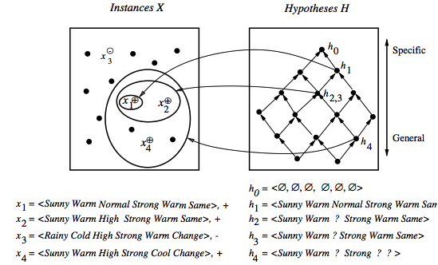
Find-S in action
Notes:
21

Slide 22
Properties of Find-S
Find-S is guaranteed to output the most specific hypothesis within H that is consistent with the positive training examples
The final hypothesis will also be consistent with the negative examples
Problems:
There can be more than one “most specific hypotheses”
We cannot say if the learner converged to the correct target
Why choose the most specific?
If the training examples are inconsistent, the algorithm can be mislead: no tolerance to rumor.
Negative example are not considered
Notes:
22

Slide 23
Candidate elimination algorithm: the idea
The idea: output a description of the set of all hypotheses consistent with the training examples (correctly classify training examples).
Version space: a representation of the set of hypotheses which are consistent with D
an explicit list of hypotheses (List-Than-Eliminate)
a compact representation of hypotheses which exploits the more_general_than partial ordering (Candidate-Elimination)
Notes:
23

Slide 24
Version space
The version space VS_{H,D} is the subset of the hypothesis from H consistent with the training example in D
VS_{H,D} ≡{h ∈ H | Consistent(h, D)}
An hypothesis h is consistent with a set of training examples D iff h(x) = c(x) for each example in D
Consistent(h, D) ≡ (∀ 〈x, c(x)〉 ∈ D) h(x) = c(x))
Note: "x satisfies h" (h(x)=1) different from “h consistent with x"
In particular when an hypothesis h is consistent with a negative example d =〈x, c(x)=No〉, then x must not satisfy h
Notes:
24
Consistente significa essere in accordo con la funzione target (un ipotesi è consistente ocn un esempio di apprendimento quando h(x) = c(x)
Un esempio soddisfa una ipotesi quando è un esempio positivo secondo l’ ipotesi (h(x) = 1).

Slide 25
The List-Then-Eliminate algorithm
Version space as list of hypotheses
VersionSpace ← a list containing every hypothesis in H
For each training example, 〈x, c(x)〉
Remove from VersionSpace any hypothesis h for which h(x) ≠ c(x)
Output the list of hypotheses in VersionSpace
Problems
The hypothesis space must be finite
Enumeration of all the hypothesis, rather inefficient
Notes:
25

Slide 26
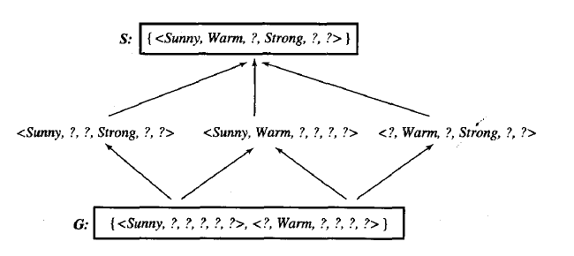
A compact representation for Version Space
Note: The output of Find-S is just 〈Sunny, Warm, ?, Strong, ?, ?〉
Version space represented by its most general members G and its most specific members S (boundaries)
Notes:
26

Slide 27

A compact representation for Version Space
The version space is represented by its most general and least general members.
These members form general and specific boundary sets that delimit the version space within the partially ordered hypothesis space.
To illustrate this representation for version spaces, consider again the Enjoysport concept learning problem
given the four training examples FIND-S outputs the hypothesis
This is just one of six different hypotheses from H that are consistent with these training examples

Slide 28
A compact representation for Version Space
They constitute the version space relative to this set of data and this hypothesis representation.
The arrows among these six hypotheses indicate instances of the more-general_than relation.
The CANDIDATE-ELIMINATlON algorithm represents
the version space by storing only its most general members G and its most specific S.
Given S,G it is possible to enumerate all members of the version space as needed by generating the hypotheses.

Slide 29
General and specific boundaries
The Specific boundary, S, of version space VS_{H,D} is the set of its minimally general (most specific) members
S ≡{s ∈ H | Consistent(s, D)∧(¬∃s' ∈ H)[(s >_{g}s') ∧ Consistent(s', D)]}
Note: any member of S is satisfied by all positive examples, but more specific hypotheses fail to capture some
The General boundary, G, of version space VS_{H,D} is the set of its maximally general members
G ≡{g ∈ H | Consistent(g, D)∧(¬∃g' ∈ H)[(g' >_{g} g) ∧ Consistent(g', D)]}
Note: any member of G is satisfied by no negative example but more general hypothesis cover some negative example
Notes:
29
In S troviamo le ipotesi più specifiche che coprono tutti gli esempi positivi; se specializzassimo ulteriormente qualche esempi positivo non sarebbe coperto.
In G troviamo il massimo della generalizzazione possibile che non copre alcun esempio negativo.

Slide 30
Version Space representation theorem
G and S completely define the Version Space
Theorem: Every member of the version space (h consistent with D) is in S or G or lies between these boundaries
VS_{H,D}={h ∈ H |(∃s ∈ S) (∃g ∈ G) (g ≥_{g} h ≥_{g} s)}
where x ≥_{g} y means x is more general or equal to y
Sketch of proof:
⇐ If g ≥_{g} h ≥_{g} s, since s is in S and h ≥_{g} s, h is satisfied by all positive examples in D; g is in G and g ≥_{g} h, then h is satisfied by no negative examples in D; therefore h belongs to VS_{H,D}
⇒ It can be proved by assuming a consistent h that does not satisfy the right-hand side and by showing that this would lead to a contradiction
Notes:
30
Supponiamo che h sia consistente con tutti gli esempi in D (+ e -) ma non sia g >= h >= s, con s in S e g in G.
h dovrebbe cadere al di fuori del reticolo e quindi essere
più specifico di qualche s in S, contro l’ ipotesi che non si possano restringere ulteriormente le ipotesi senza escludere qualche esempio positivo
più generale di qualche ipotesi in g, contro l’ ipotesi che non si possano generalizzare ipotesi senza coprire qualche esempio negativo.
o più generale qualche g in G

Slide 31


Candidate elimination Learning algorithm
The CANDIDATE-ELIMINATiON algorithm computes the version space containing all hypotheses from H that are consistent with an observed sequence of training
examples.
initializing the version space to the set of all hypotheses in H
Each training example is considered, the S and G boundary sets are generalized and specialized, respectively.
After all examples have been processed, the computed version space contains all the hypotheses consistent with these examples and only these hypotheses

Slide 32
Candidate elimination algorithm-1
S ← minimally general hypotheses in H,
G ← maximally general hypotheses in H
Initially any hypothesis is still possible
S₀ = 〈∅, ∅, ∅, ∅, ∅, ∅〉 G₀ = 〈?, ?, ?, ?, ?, ?〉
For each training example d, do:
If d is a positive example:
Remove from G any h inconsistent with d
Generalize(S, d)
If d is a negative example:
Remove from S any h inconsistent with d
Specialize(G, d)
Note: when d =〈x, No〉 is a negative example, an hypothesis h is inconsistent with d iff h satisfies x
Notes:
32

Slide 33
Candidate elimination algorithm-2
Generalize(S, d): d is positive
For each hypothesis s in S not consistent with d:
Remove s from S
Add to S all minimal generalizations of s consistent with d and having a generalization in G
Remove from S any hypothesis with a more specific h in S
Specialize(G, d): d is negative
For each hypothesis g in G not consistent with d: i.e. g satisfies d,
Remove g from G but d is negative
Add to G all minimal specializations of g consistent with d and having a specialization in S
Remove from G any hypothesis having a more general hypothesis in G
Notes:
33

Slide 34
Example: initially
S₀:
〈∅, ∅, ∅, ∅, ∅. ∅〉
G₀
〈?, ?, ?, ?, ?, ?〉
Notes:
34

Slide 35
Example: after seeing 〈Sunny,Warm, Normal, Strong, Warm, Same 〉 +
S₀:
〈∅, ∅, ∅, ∅, ∅. ∅〉
S₁:
〈Sunny,Warm, Normal, Strong, Warm, Same〉
G₀, G₁
〈?, ?, ?, ?, ?, ?〉
Notes:
35

Slide 36
Example: after seeing <Sunny,Warm, High, Strong, Warm, Same〉+
S₁:
〈Sunny,Warm, Normal, Strong, Warm, Same〉
S₂:
〈Sunny,Warm, ?, Strong, Warm, Same〉
G₁, G₂
〈?, ?, ?, ?, ?, ?〉
Notes:
36

Slide 37
Example: after seeing 〈Rainy, Cold, High, Strong, Warm, Change 〉−
S_{2,} S₃:
〈Sunny, Warm, ?, Strong, Warm, Same〉
G₃:
〈Sunny, ?, ?, ?, ?, ?〉 〈?, Warm, ?, ?, ?, ?〉 〈?, ?, ?, ?, ?, Same〉
G₂:
〈?, ?, ?, ?, ?, ?〉
Notes:
37

Slide 38
Example
This negative example reveals that the G boundary of the version space is overly general
The hypothesis in the G boundary must therefore
be specialized until it correctly classifies this new negative example
Given that there are six attributes that could be specified to specialize G2, why are there only three new hypotheses in G3?
The hypothesis h = (?, ?, Normal, ?, ?, ?) is a minimal specialization of G2 that correctly labels the new example as a negative example.

Slide 39
Example
It is not included in G3 as it is inconsistent with the previously
encountered positive examples.
The S boundary of the version space forms a summary of the previously encountered positive examples
The G boundary summarizes the information from previously encountered negative examples

Slide 40
Example: after seeing 〈Sunny, Warm, High, Strong, Cool, Change 〉 +
S₃
〈Sunny, Warm, ?, Strong, Warm, Same〉
S₄
〈Sunny, Warm, ?, Strong, ?, ?〉
G₄:
〈Sunny, ?, ?, ?, ?, ?〉 〈?, Warm, ?, ?, ?, ?〉
G₃:
〈Sunny, ?, ?, ?, ?, ?〉 〈?, Warm, ?, ?, ?, ?〉 〈?, ?, ?, ?, ?, Same〉
Notes:
40

Slide 41
Example
The fourth training example further generalizes the
S boundary of the version space
It also results in removing one member of the G
boundary, because this member fails to cover the new positive example.
This learned version space is independent of the sequence in which the training examples are presented
As further training data is encountered, the S and G boundaries will move monotonically closer to each other, delimiting a smaller and smaller version space of candidate hypotheses.

Slide 42
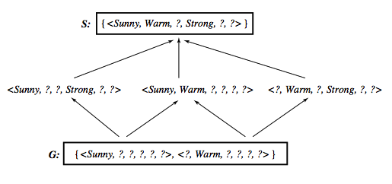
Learned Version Space
Notes:
42

Slide 43
Observations
The learned Version Space correctly describes the target concept, provided:
There are no errors in the training examples
There is some hypothesis that correctly describes the target concept
If S and G converge to a single hypothesis the concept is exactly learned
In case of errors in the training, useful hypothesis are discarded, no recovery possible
An empty version space means no hypothesis in H is consistent with training examples
Notes:
43

Slide 44
Ordering on training examples
The learned version space does not change with different orderings of training examples
Efficiency does
Learner is allowed to choose the next instance :
Generate instances that satisfy half the hypotheses in the current version space. For example:
〈Sunny, Warm, Normal, Light, Warm, Same〉 satisfies 3/6 hyp.
If the trainer classifies this as positive then S can be generalized otherwise G can be specialized.
Notes:
44

Slide 45
Ideally the VS can be reduced by half at each experiment
Correct target found in ⎡log₂|VS|⎤ experiments.
In general it may not be possible to construct an instance that matches precisely half the hypotheses.
In such cases, a larger number of queries may be required than ⎡log₂|VS|⎤ .

Slide 46
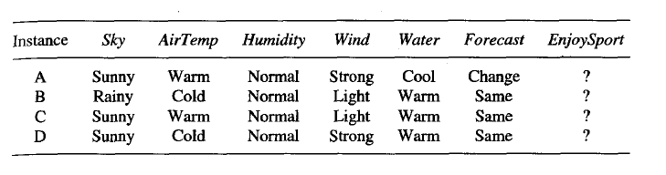
Use of partially learned concepts

Slide 47
Use of partially learned concepts
Classified as positive by all hypothesis, since satisfies any hypothesis in S
Notes:
47

Slide 48
Classifying new examples
Classified as negative by all hypothesis, since does not satisfy any hypothesis in G
Notes:
48

Slide 49
Classifying new examples
Uncertain classification: half hypothesis are consistent, half are not consistent
Notes:
49

Slide 50
Classifying new examples
〈Sunny, Cold, Normal, Strong, Warm, Same〉
4 hypothesis not satisfied; 2 satisfied
Probably a negative instance. Majority vote?
Notes:
50

Slide 51
Bibliography
Machine Learning, Tom Mitchell, Mc Graw-Hill International Editions, 1997 (Cap 2).
Notes:
51

